Slide 1
Caravan Insurance Data Analytics
Build a predictive model to foresee who is likely going to buy insurance
Jun Yuan

Slide 2
Project Purpose
Can we predict who are going to buy insurance based on collected demographic characteristics.
  Build a predictive model using the K-Nearest Neighbors (KNN) classifier.
Key benefit: more cost-effective marketing strategy for future revenue increase.
  Historical data shows less than 6% (348 out of 5822) of people purchased caravan insurance.
    How to improve the sale?
    Can we predict who may likely buy insurance?
  Marketing efforts focus more on Potential Buyers.
    Potential Buyers = people with positive predicted responses from the final predictive model.

Slide 3
Analytic Approach (1)
Build predictive model using the KNN approach.
  Standardize the input data so that all predictors are on a comparable scale
    A mean of ZERO and standard deviation of ONE for all variables.
  Evaluate and compare KNN model performance with different choices of K, e.g. K=1,2,3,4,5,…
Model performance definition.
  A dummy prediction already has over 94% accuracy rate.
    Just to predict: nobody will buy insurance.
  How to evaluate model performance in this particular case?
    What we care more about?
      The fraction of individuals that are correctly predicted to buy insurance.
    This is what being called the Precision of the predictive model.
      The precision of random guess is 6%, and what can we do better?

Slide 4
Analytic Approach (2)
Data preparation.
  Standardize data.
  Randomly partition data into training and testing datasets.
    1000 records are held out for testing purpose
    4882 records are used for model training.
  data.sd=scale(Caravan[,-86])
  set.seed(2)
  test_ind=sample(seq_len(nrow(data.sd)), size=1000)
  data.sd.train=data.sd[-test_ind,]
  data.sd.test=data.sd[test_ind,]
  train.y = Caravan$Purchase[-test_ind]
  test.y=Caravan$Purchase[test_ind]
Standardize data
Randomly divide dataset to avoid unnecessary biases introduced during partition

Slide 5
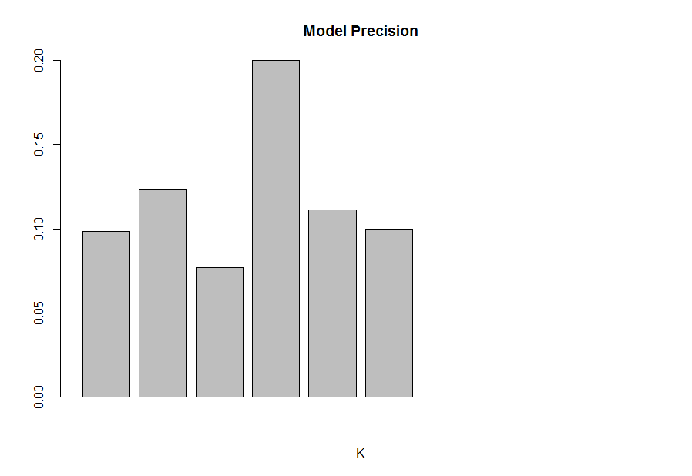
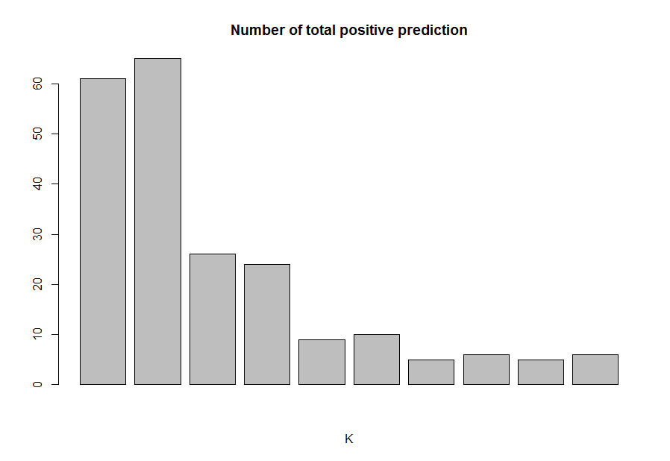
Analytic Approach (3)
Model fitting and evaluation process.
  Use KNN classifier to fit the model with K=1,2,…,10 respectively.
  Calculate precision for each model.
  Record the total number of positive prediction on test data for each model.
  Observations:
    The precision reach highest when k =4.
    Precision decreases to zero when k > 6
    The total number of positive prediction decreases when k increases. (we would like to see reasonable number of positive prediction as well)
The highest precision 20% (k=4)
Total number of positive prediction is 25 (k=4)

Slide 6
Analytic Approach (3)
Final Model
  The final model is when K=4
    The model has highest precision (20%), while still have reasonable size of position prediction on test data.
    knn.pred=knn(data.sd.train,data.sd.test,train.y,k=4)
    table(knn.pred, test.y)
    numOfPositive=sum(knn.pred=="Yes")
    precision = sum(test.y=="Yes" & knn.pred=="Yes")/sum(knn.pred=="Yes")

Slide 7
Results(1)
Summary of performance
  The final model has 20% precision which is more than 3 times better than a random guess.
  The final model has the ability to deliver reasonable size of positive prediction.
Confusion Matrix
Predicted value
 | No | Yes
No | 927 | 20
Yes | 48 | 5
True value

Slide 8
Results(2)
Error rates
False Pos. Rate | 20/947 | 2.1%
True Pos. Rate | 5/53 | 9.4%
Pos. Pred Value | 5/25 | 20%
Neg. Pred Value | 927/975 | 95.1%
More discussions next slide

Slide 9
Error Analysis
Precision vs. Sensitivity
  The model delivers acceptable Precision (20%), but the Sensitivity is relatively low (9.4)%.
    When them predicts a person would buy the insurance, it may be right at 20% rate, .
      At least 3 times better than random guess.
    However, the model may only be able to predict 9.4% right out of the entire buyers.
      May not be good enough in terms of coverage.
Possible solution
  Try other classification methods.
    Logistic regression.
    Linear Discriminant Analysis (LDA)
    Quadratic Discriminant Analysis (QDA).

Slide 10
Actionable Information or Insights
The classification method (KNN) is helpful in predicting potential buyers.
  At least 3 times better than random guess.
    There is about 20% chance for the predicted potential buyers to buy the insurance.
  However, the result is not perfect, and there is still room for improvement.
Possible action from analysis.
  Propose a new marketing initiative focusing on potential buyers by leveraging the predictive model.

Slide 11
Future Work
What may further improve model performance.
  Get additional data and features.
  Try out other classification methods, such as Logistic regression, LDA, and QDA.
Validate the effectiveness of the new marketing approach via A/B testing.
  Two marketing efforts, one is guided by the predictive model, and the other is still based on the random guess.
  Test if there is noticeable difference between the two.

